Slide 1
SLEEP
Ignored until disrupted

Slide 2
normal Sleep
Consists of 2 components
NREM (Non rapid eye movement)
Rem (Rapid eye movement)
Also known as dream sleep

Slide 3
Normal sleep
NREM sleep can be broken into 3 stages
Stage 1
Transition between wake and sleep
Normally lasts between 1-7 minutes
Relaxed with eyes closed and with fleeting thoughts
Easily awakened, and will often say they have not been asleep

Slide 4
Normal sleep
Stage 2
Body temperature starts to decrease
Heart rate begins to slow
More difficult to awaken
Stage 3
People become less responsive and noises
Activity in the environment may fail to generate a response
Bed-wetting and sleepwalking are most likely to occur at the end of this stage

Slide 5
Normal sleep
REM sleep
Known as dream sleep
Voluntary muscles paralysed to prevent acting out dreams
Associated with processing emotions, problem solving, retaining memories, and relieving stress
Vital to learning
In children growth hormones are released
If disrupted the brain will try to “catch up” next time

Slide 6
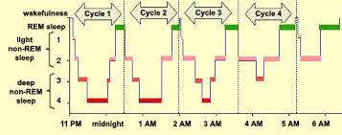
Normal sleep
Cycle through sleep stages up to 5 times a night
Stage 3 and REM sleep get longer through the night

Slide 7
Effect of poor sleep
Daytime drowsiness
Trouble concentrating
Irritability
Increased risk of falls and accidents
Lower productivity
Decreased memory recall

Slide 8
Signs of sleep deprivation
Difficulty waking in the morning
Poor job performance
Increased clumsiness
Difficulty making decisions
Falling asleep/ dozing during work
Feeling especially moody or irritated

Slide 9
Sleep and pain
Sleep quality is more likely to predict the next days mood and physical symptoms than the reverse
Pain
Disrupted sleep
insomnia
Magnification of pain

Slide 10
Sleep and pain
In the 2015 Sleep America poll
The gap between the amount of sleep people say the need and what they get
0 minutes people with no pain
14 minutes acute pain (1 week)
42 minutes chronic pain
Poor sleepers report significantly more pain than those with higher sleep quality
Poor sleep impairs coping strategies
Medication to alleviate pain may affect sleep, e.g. insomnia, alterations in sleep patterns

Slide 11
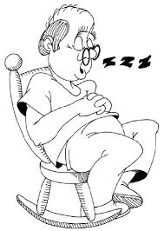
Sleep in the Aging population
The need for sleep doesn’t change, but the needs may be met
differently
Sleep problems are only problems if the person concerned
considers them problems
Don’t project what we see as abnormal sleep onto the
person we are talking to.
Poor sleepers who are elderly appear less affected by sleep loss
than those who are younger

Slide 12
Sleep in the Aging population
Causes of daytime sleepiness in the elderly, due to poor night sleep
Obstructive Sleep Apnoea
Pain
Sleep related movement
Depression
Medication
Indirectly interrupts sleep, e.g. ACE inhibitors can cause a cough which worsens at night
Affects the sleep cycle, e.g. beta blockers can cause insomnia
Nocturia, due to medication or aging
Disease processes e.g. diabetes, arthritis, cardiovascular conditions, heartburn

Slide 13
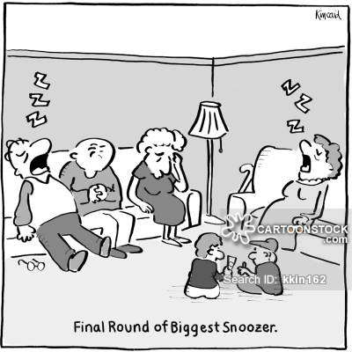
Sleep in the Aging population
Changes in sleep
Spend more time in lighter levels of sleep
Increased sleep latency
Increased sleep fragmentation
Decreased REM
Increased risk of sleep disorders
Insomnia
Snoring
Restless legs

Slide 14
Treatment ?
The first line of treatment is sleep hygiene
Avoid caffeine, alcohol, and nicotine in the evening
Avoid heavy meals for 2 hours before bed
Avoid energetic exercise for 3 hours before bed
Have a restful hour before bed
Ensure you bedroom is a quiet restful area
The bedroom is only for sleep and sex

Slide 15
Sleep Hygiene
Develop a bedtime routine, so your brain recognises the “slow down” signals
Keep regular sleep and wake times, helps regulate sleep
If you can’t get to sleep after about 20 minutes, get up and do something that makes you sleepy, then go back to bed
If these don’t work discuss the issue with the GP
Treatment with bright light therapy may be suitable if the sleep cycle has been altered

Slide 16
Insomnia and Bright Light Therapy
Delayed Sleep Phase Syndrome - Sleep onset insomnia
Can be treated successfully with bright light when they wake
Advanced Sleep Phase Syndrome - Waking very very early in the morning and unable to go back to sleep.
Can be treated before they go to sleep and to keep them from sleeping too early in the afternoon or evening

Slide 17
